Slide 1
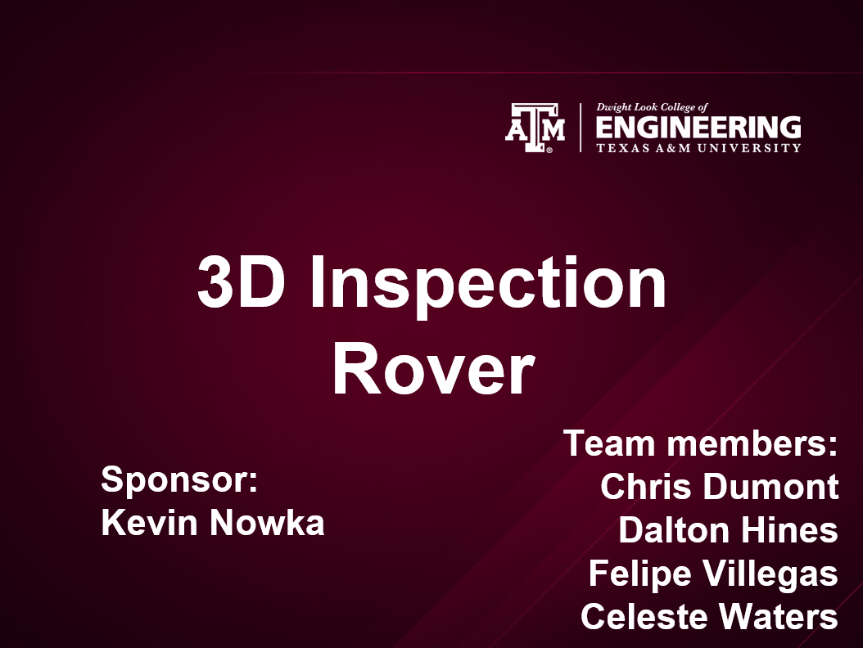

Slide 2
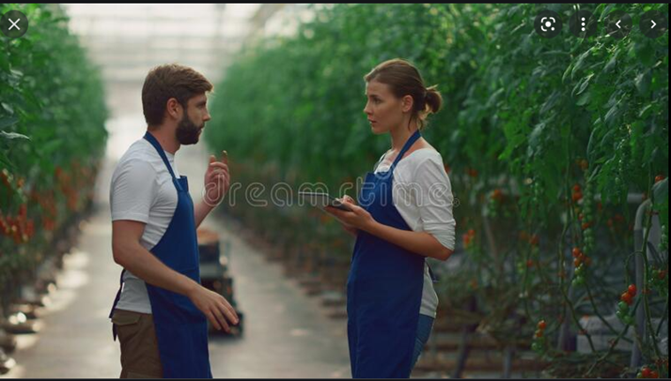
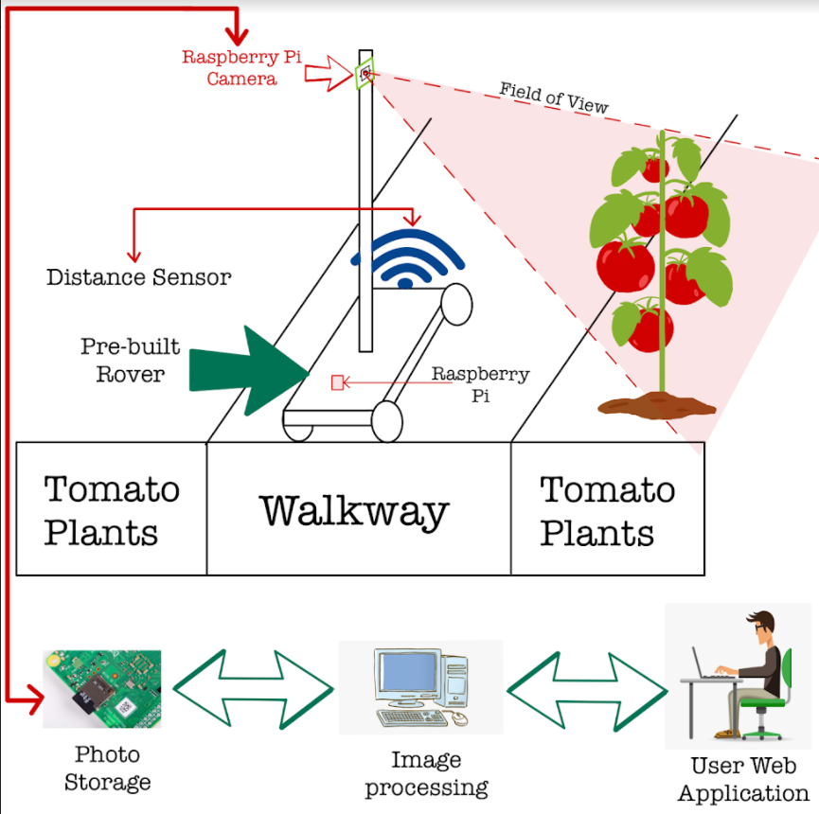
Problem
Solution
Tomato classifying is a time consuming process
A rover that will navigate the greenhouse and classify all the tomatoes autonomously

Slide 3
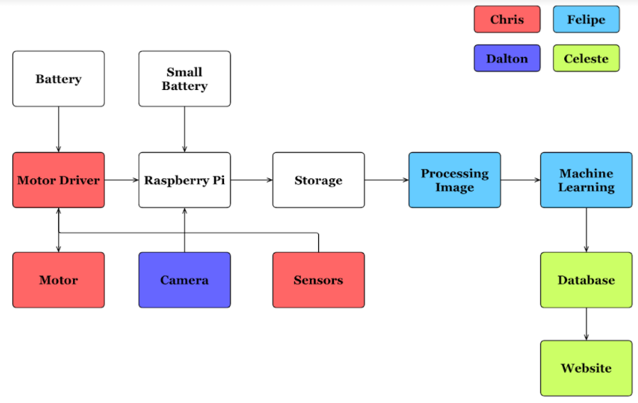
Team: 3D Inspection Rover

Slide 4
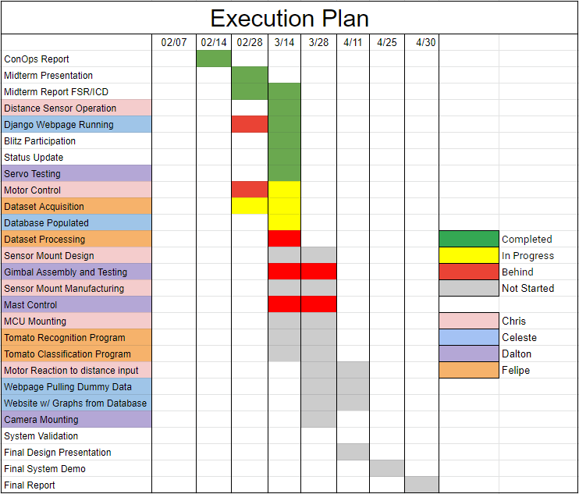
Team: 3D Inspection Rover

Slide 5
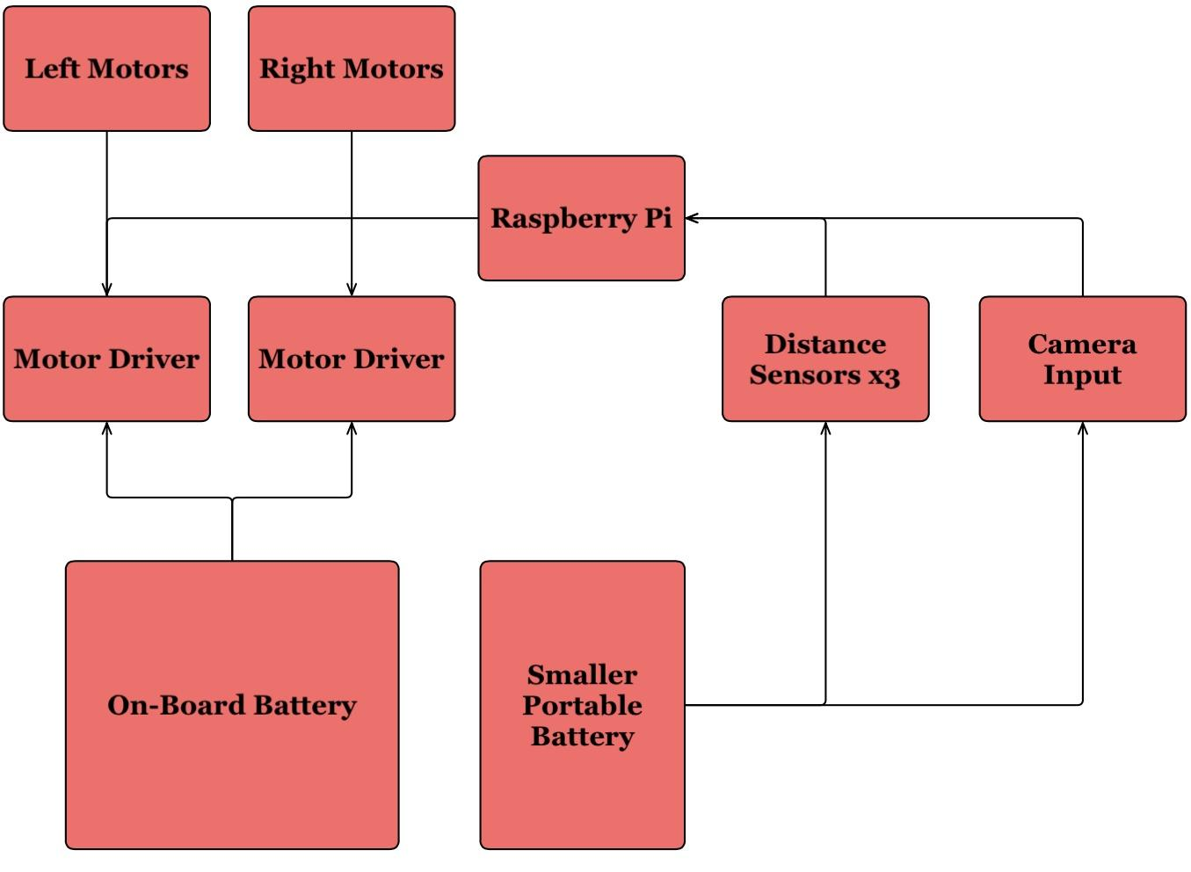
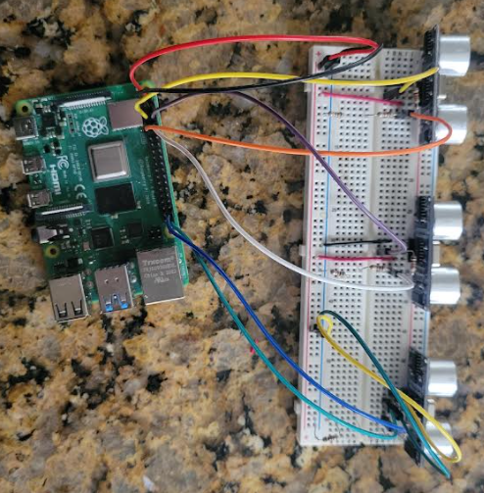
Navigation
Chris Dumont
Accomplishments since the last presentation 30 hrs | Ongoing progress/problems and plans until the next presentation
Completed Testing of distance sensors across multiple materials at distances from 6 inches to 8.5 ft Basic code written for motor control based on distance readings | Mounting Distance sensors Control of motor driver Motor reacting to distance readings accurately Motor reacting to distance to next plant

Slide 6
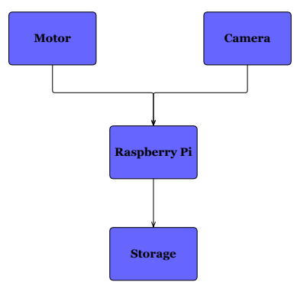
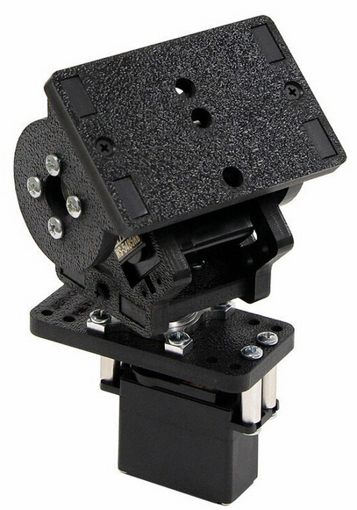
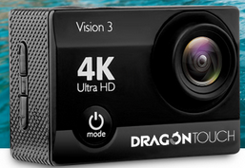
Camera Positioning & Image Taking Dalton Hines
Accomplishments since the last presentation 30 hrs | Ongoing progress/problems and plans until the next presentation
Base code for camera positioning Servo motor movement | Mast movement and construction Gimbal and camera connectivity Control of mast and gimbal together

Slide 7
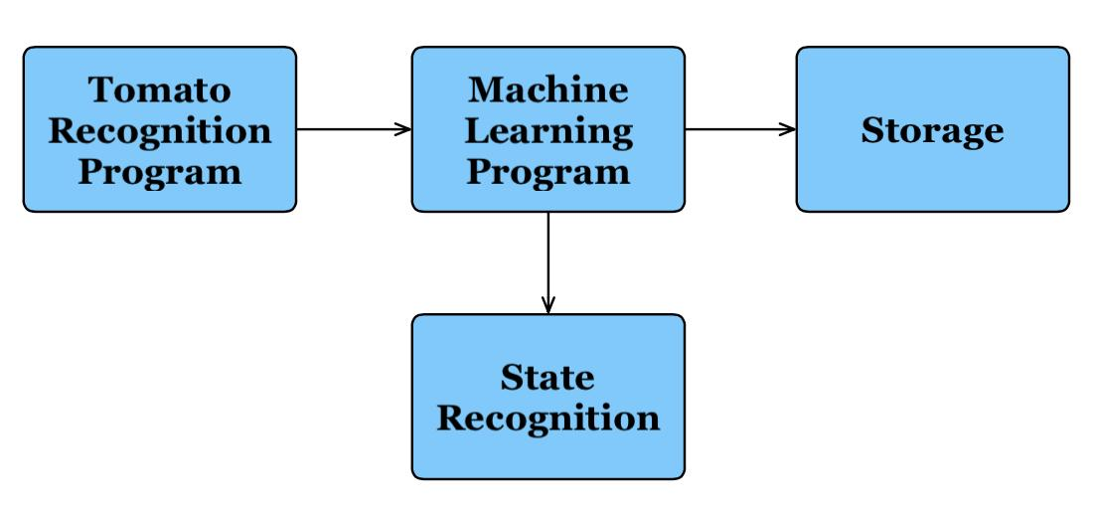
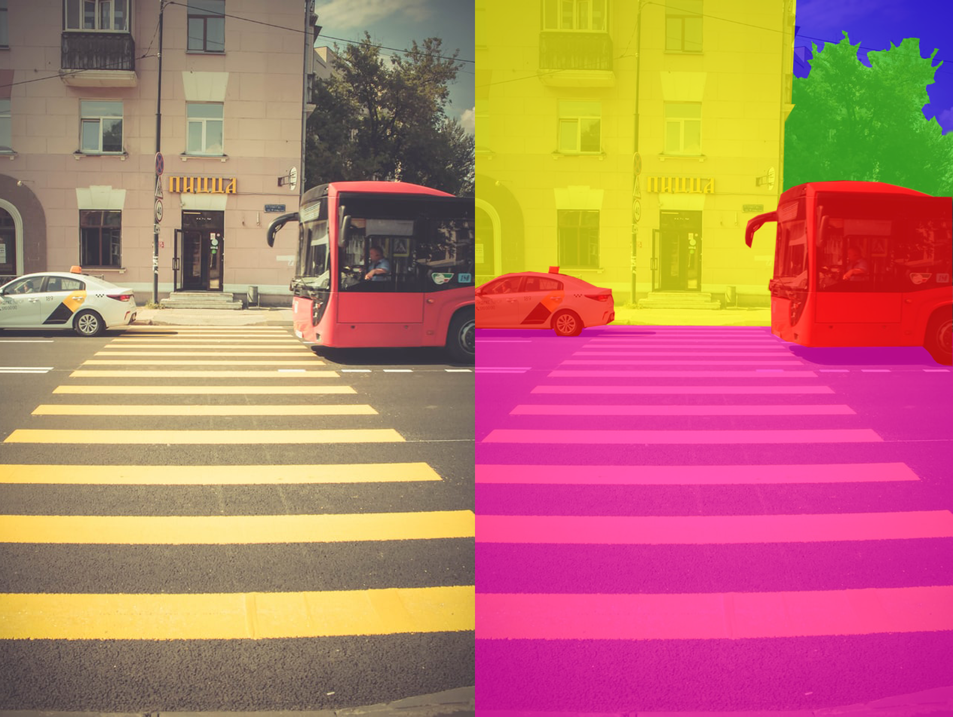
Tomato Recognition and Classification Felipe Villegas
Accomplishments since the last presentation 30hrs | Ongoing progress/problems and plans until the next presentation
Image dataset for tomato recognition and classification | Tomato Classification CNN Implementation Tomato Recognition Program Mask R-CNN Implementation

Slide 8
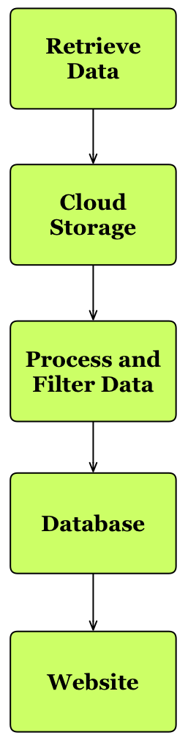
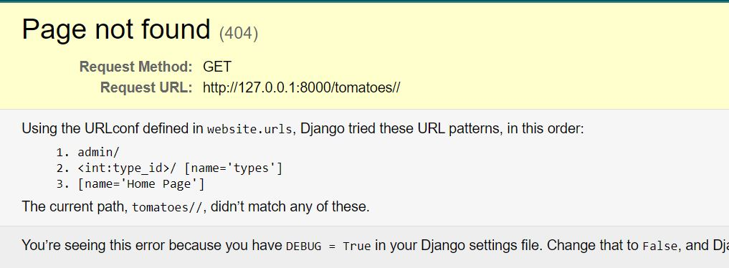
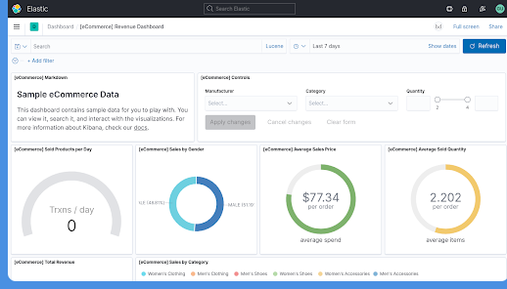
Database, Website, Cloud Computing Celeste Waters
Accomplishments since the last presentation 35 hrs | Ongoing progress/problems and plans until the next presentation
Clickable Webpage Error pages (404) Authentication Admin page (login) | Populated database (small) Graphed data Organized website

Slide 9
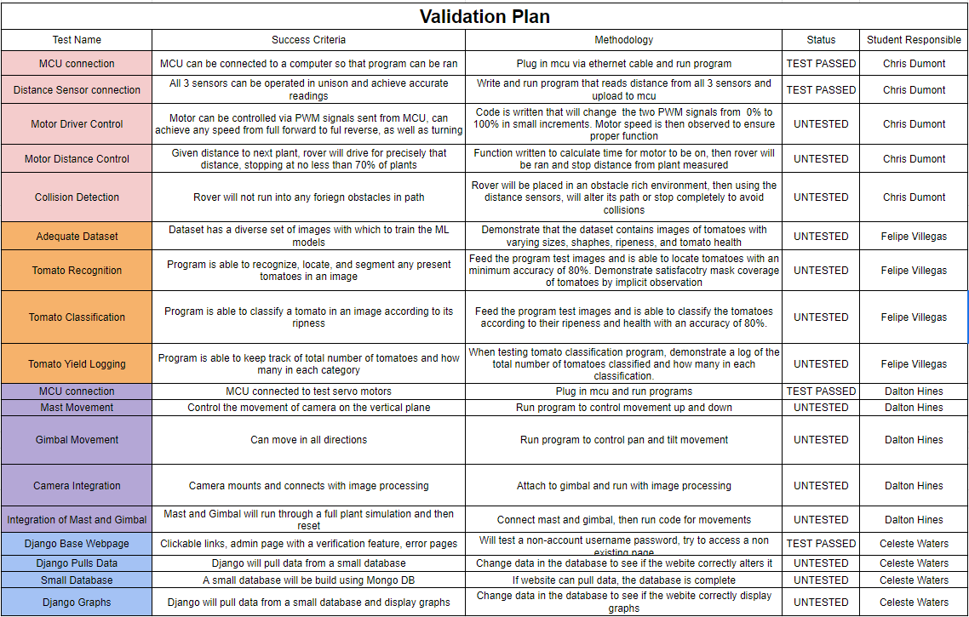
Team: 3D Inspection Rover

Slide 10
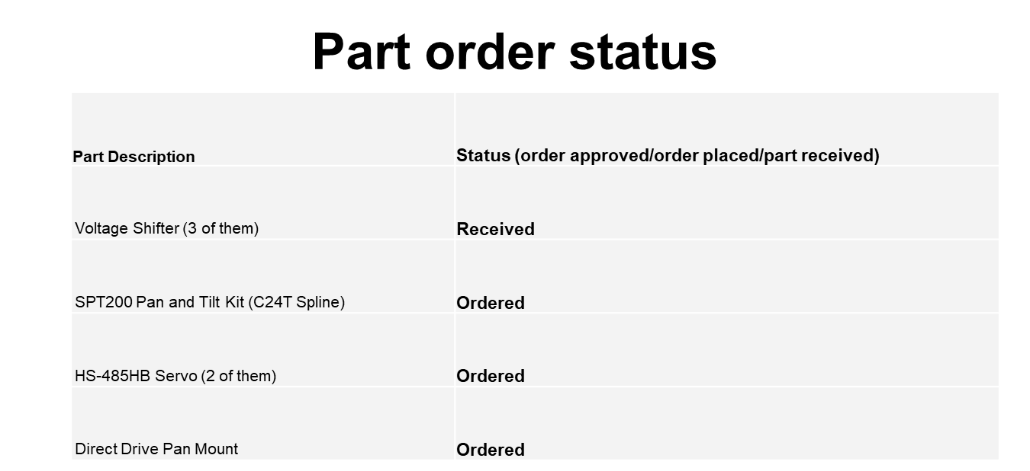

Slide 11
QUESTIONS?

